Slide 1
Virtual Memory
Paging

Slide 2
Virtual Memory
There is a need to run programs that are too large to fit in memory.
Overlaying technique : Solution adopted in the 1960s, split programs into little pieces, called overlays
  Kept on the disk, swapped in and out of memory
  This technique requires the programmers to specify which overlay to load at different circumstances.
Virtual memory : each program has its own address space, broken up into chunks called pages

Slide 3
Virtual Memory – Paging
The method that was devised (Fotheringham, 1961) has come to be known as virtual memory. The basic idea behind virtual memory is that each program has its own address space, which is broken up into chunks called pages. Each page is a contiguous range of addresses. These pages are mapped onto physical memory, but not all pages have to be in physical memory at the same time to run the program. When the program references a part of its address space that is in physical memory, the hardware performs the necessary mapping on the fly. When the program references a part of its address space that is not in physical memory, the operating system is alerted to go get the missing piece and re-execute the instruction that failed.

Slide 4
Paging (1)
In a sense, virtual memory is a generalization of the base-and-limit-register idea. The 8088 had separate base registers (but no limit registers) for text and data. With virtual memory, instead of having separate relocation for just the text and data segments, the entire address space can be mapped onto physical memory in
fairly small units. We will show how virtual memory is implemented below.
Virtual memory works just fine in a multiprogramming system, with bits and pieces of many programs in memory at once. While a program is waiting for pieces of itself to be read in, the CPU can be given to another process.

Slide 5
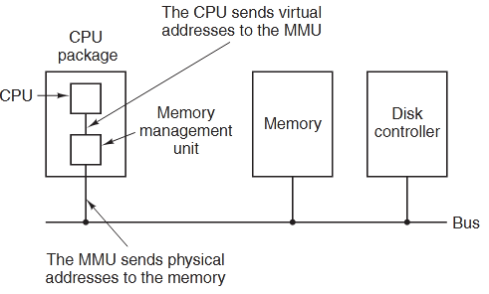
Paging (2)
Most virtual memory systems use a technique called paging, which we will now describe. On any computer, programs reference a set of memory addresses. When a program executes an instruction like MOV REG,1000 it does so to copy the contents of memory address 1000 to REG (or vice versa, depending on the computer). Addresses can be generated using indexing, base registers, segment registers, and other ways.
The position and function of the MMU.
Here the MMU is shown as being a part of the CPU chip because it commonly is nowadays. However, logically it could be a separate chip and was years ago.
These program-generated addresses are called virtual addresses and form the
virtual address space.

Slide 6
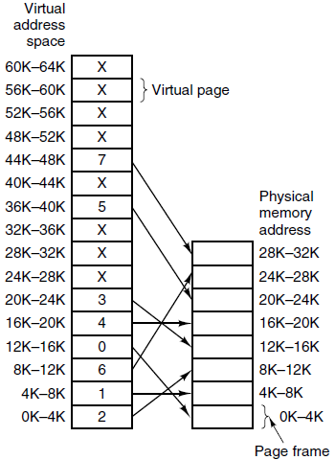
Paging (3)
Page table in main memory
The relation between virtual addresses and physical memory addresses is given by the page table. In this example, every page begins on a multiple of 4096 and ends 4095 addresses higher, so 4K–8K really means 4096–8191 and 8K-12K means 8192–12287
Virtual page: page in virtual memory.
Page frame: page in physical memory.
Page frame corresponding to to the virtual page may not yet exist in the physical memory and page frame number may be different from virtual page number.

Slide 7
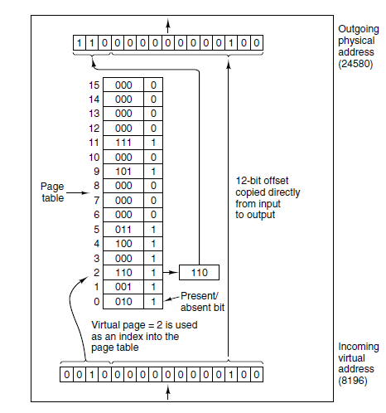
Paging (4)
The internal
operation of the MMU
with 16 4-KB pages.
Page frame
Virtual page

Slide 8
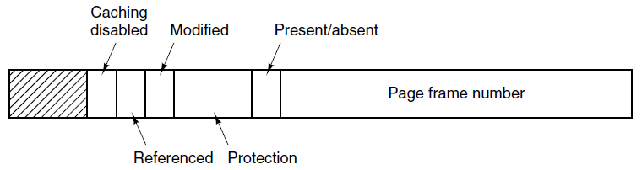
Structure of Page Table Entry in Page Table
A typical page table entry.
Page table has page table entries where each page table entry stores a frame number and optional status (like protection) bits.
Page frame number is the most important field.
Present/absent or valid/invalid bit: 1 present, 0 not present in RAM.
Protection or read/write bit: 0 for read/write, 1 for read only.
Modified or dirty bit: it is set to 1 if the page is just modified.
Referenced (R) bit, when the page is referenced, it is set to 1, if after certain time not referenced, R is set to 0. Thus R=0 means that the page is not used for long time.
Caching enable/disabled.

Slide 9
Implementation of Page Table
Page table is kept in main memory
Page-table base register (PTBR) points to the page table
Page-table length register (PRLR) indicates size of the page table
In this scheme every data/instruction access requires two memory accesses. One for the page table and one for the data/instruction.
The two memory access problem can be solved by the use of a special fast-lookup hardware cache called associative memory or Translation Look-aside Buffers (TLBs)

Slide 10
Speeding Up Paging
Major issues faced:
The mapping from virtual address to physical address must be fast.
If the virtual address space is large, the page table will be large.

Slide 11
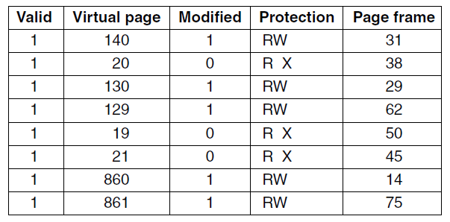
Translation Look-aside Buffers (1)
A TLB to speed up paging.
A translation lookaside buffer (TLB) is a memory cache that is used to reduce the time taken to access a user memory location.[1] It is a part of the chip's memory-management unit (MMU). The TLB stores the recent translations of virtual memory to physical memory and can be called an address-translation cache. A TLB may reside between the CPU and the CPU cache, between CPU cache and the main memory or between the different levels of the multi-level cache.

Slide 12

Paging Hardware With TLB

Slide 13
Page Tables for Large Memories - Multilevel Page Tables (1)
TLBs can be used to speed up virtual-to-physical address translation over the original page-table-in-memory scheme. But that is not the only problem we have to tackle. Another problem is how to deal with very large virtual address spaces. Each program needs its own page table, thus if many programs are running at the same times then their page tables may need very large memory. We can’t swap the page tables out to disk, because if the table is not in RAM, we have no way to access it.
Below we will discuss two ways of dealing with them: Multilevel Page Tables and Inverted Page Tables.

Slide 14
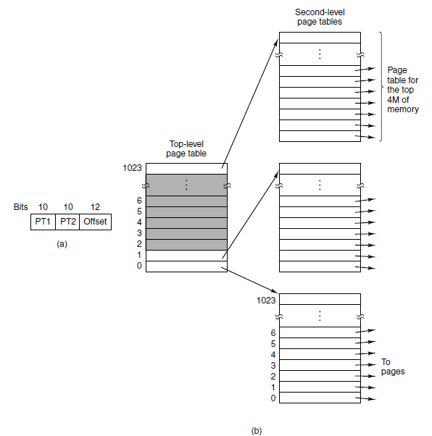
Multilevel Page Tables (2)
(a) A 32-bit address with two page table fields. (b) Two-level page tables.

Slide 15
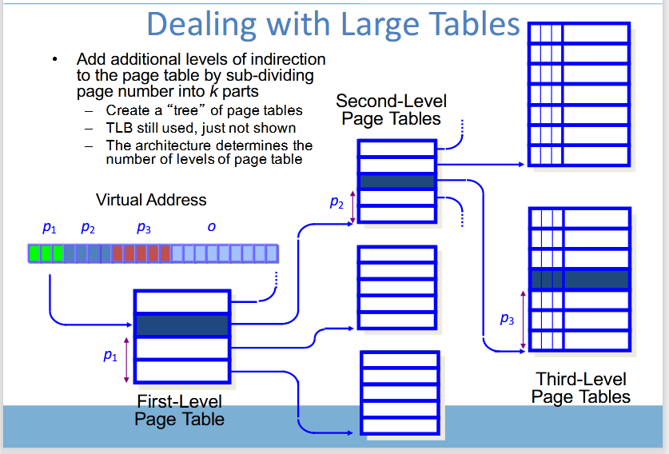
Multilevel Page Tables (2)

Slide 16
Inverted Page Tables (1)
Most Operating Systems implement a separate page table for each process, i.e. for n number of processes running on a Multiprocessing/ Timesharing operating system, there is n number of page tables stored in the memory. Sometimes when a process is very large in size and it occupies virtual memory then with the size of the process, its page table size also increases substantially.
Inverted Page Table is the global page table which is maintained by the Operating System for all the processes. In inverted page table, the number of entries is equal to the number of frames in the main memory. It can be used to overcome the drawbacks of page table.

Slide 17
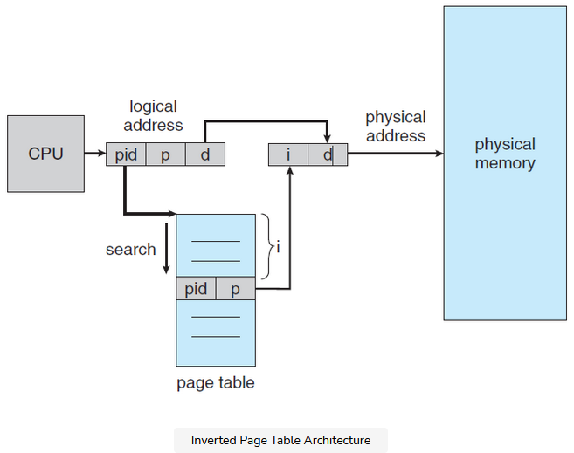
Inverted Page Tables (2)

Slide 18
Page Replacement problems (1)
In an operating system that uses paging for memory management, a page replacement algorithm is needed to decide which page needs to be replaced when new page comes in.
Page Fault – A page fault happens when a running program accesses a memory page that is mapped into the virtual address space, but not loaded in physical memory.
Since actual physical memory is much smaller than virtual memory, page faults happen. In case of page fault, Operating System might have to replace one of the existing pages with the newly needed page. Different page replacement algorithms suggest different ways to decide which page to replace. The target for all algorithms is to reduce the number of page faults.

Slide 19
Page Replacement problems (2)
It is worth noting that the problem of ‘‘page replacement’’ occurs in other areas of computer design as well. For example, most computers have one or more memory caches consisting of recently used 32-byte or 64-byte memory blocks. When the cache is full, some block has to be chosen for removal. This problem is precisely the same as page replacement except on a shorter time scale (it has to be done in a few nanoseconds, not milliseconds as with page replacement). The reason for the shorter time scale is that cache block misses are satisfied from main memory, which has no seek time and no rotational latency.
A second example is in a Web server. The server can keep a certain number of
heavily used Web pages in its memory cache. However, when the memory cache is full and a new page is referenced, a decision has to be made which Web page to evict.
In all the page replacement algorithms to be studied below, a certain issue arises: when a page is to be evicted from memory, does it have to be one of the
faulting process’ own pages, or can it be a page belonging to another process? In
the former case, we are effectively limiting each process to a fixed number of pages; in the latter case we are not. Both are possibilities. We will come back to this later.

Slide 20
Page Replacement Algorithms (1)
Optimal Page replacement
Not recently used algorithm
First-in, first-out (FIFO) algorithm
Second-chance algorithm
Clock algorithm
Least recently used (LRU) algorithm
Working set algorithm
WSClock algorithm

Slide 21
Optimal Page replacement algorithm
In this algorithm, pages are replaced which would not be used for the longest duration of time in the future.
Optimal page replacement is perfect, but not possible in practice as the operating system cannot know future requests. The use of Optimal Page replacement is to set up a benchmark so that other replacement algorithms can be analyzed against it.

Slide 22
Not recently used (NRU) algorithm (1)
In order to allow the operating system to collect useful page usage statistics, most computers with virtual memory have two status bits, R and M, associated with each page. R is set (to 1) whenever the page is referenced (read or written). M is set (to 1) when the page is written to (i.e., modified). The bits are contained in each page table entry. It is important to realize that these bits must be updated on every memory reference, so it is essential that they be set by the hardware. Once a bit has been set to 1, it stays 1 until the operating system resets it.

Slide 23
Not recently used (NRU) algorithm (2)
When a page fault occurs, the operating system inspects all the pages and divides them into four categories based on the current values of their R and M bits:
Class 0: not referenced, not modified.
Class 1: not referenced, modified.
Class 2: referenced, not modified.
Class 3: referenced, modified.
The NRU (Not Recently Used) algorithm removes a page at random from the lowest-numbered nonempty class.

Slide 24
First-in, first-out (FIFO) algorithm
The operating system maintains a list of all pages currently in memory, with the most recent arrival at the tail and the least recent arrival at the head. On a page fault, the page at the head is removed and the new page added to the tail of the list. The disadvantage of the FIFO method is that it may remove still useful module, e.g. OS modules, because these are stored early in memory.

Slide 25
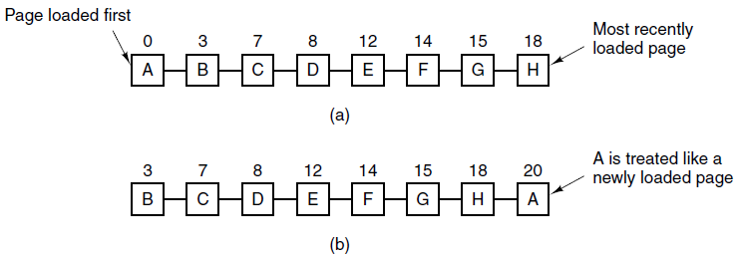
Second-chance algorithm
A simple modification to FIFO that avoids the problem of throwing out a heavily used page is to inspect the R bit of the oldest page. If it is 0, the page is both old and unused, so it is replaced immediately. If the R bit is 1, the bit is cleared, the page is put onto the end of the list of pages, and its load time is updated as though it had just arrived in memory. Then the search continues.

Slide 26
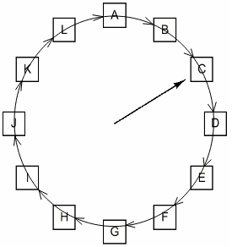
The Clock Page Replacement algorithm
Although second chance is a reasonable algorithm, it is unnecessarily inefficient because it is constantly moving pages around on its list. A better approach is to keep all the page frames on a circular list in the form of a clock, as shown in Fig. aside. The hand points to the oldest page
When a page fault occurs, the page being pointed to by the hand is inspected. If its R bit is 0, the page is evicted, the new page is inserted into the clock in its place, and the hand is advanced one position. If R is 1, it is cleared and the hand is advanced to the next page. This process is repeated until a page is found with R = 0. Not surprisingly, this algorithm is called clock.
When a page fault occurs, the page the hand is pointing to is inspected.
The action taken depends on the R bit:
R = 0: Evict the page
R = 1: Clear R and advance hand (e.g. set head = head.next;)

Slide 27
The Least Recently Used (LRU) algorithm (1)
A good approximation to the optimal algorithm is based on the observation that pages that have been heavily used in the last few instructions will probably be heavily used again soon. Conversely, pages that have not been used for ages will probably remain unused for a long time. This idea suggests a realizable algorithm:
when a page fault occurs, throw out the page that has been unused for the longest time. This strategy is called LRU (Least Recently Used) paging.
Although LRU is theoretically realizable, it is not cheap by a long shot. To fully implement LRU, it is necessary to maintain a linked list of all pages in memory. The difficulty is that the list must be updated on every memory reference.

Slide 28
The Least Recently Used (LRU) algorithm (2)
However, there are other ways to implement LRU with special hardware. Let us consider the simplest way first. This method requires equipping the hardware with a 64-bit counter, C, that is automatically incremented after each instruction. Furthermore, each page table entry must also have a field large enough to contain the counter. After each memory reference, the current value of C is stored in the page table entry for the page just referenced. When a page fault occurs, the operating system examines all the counters in the page table to find the lowest one. That page is the least recently used.

Slide 29
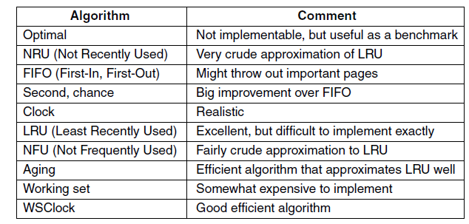
Summary of Page Replacement Algorithms

